Slide 1

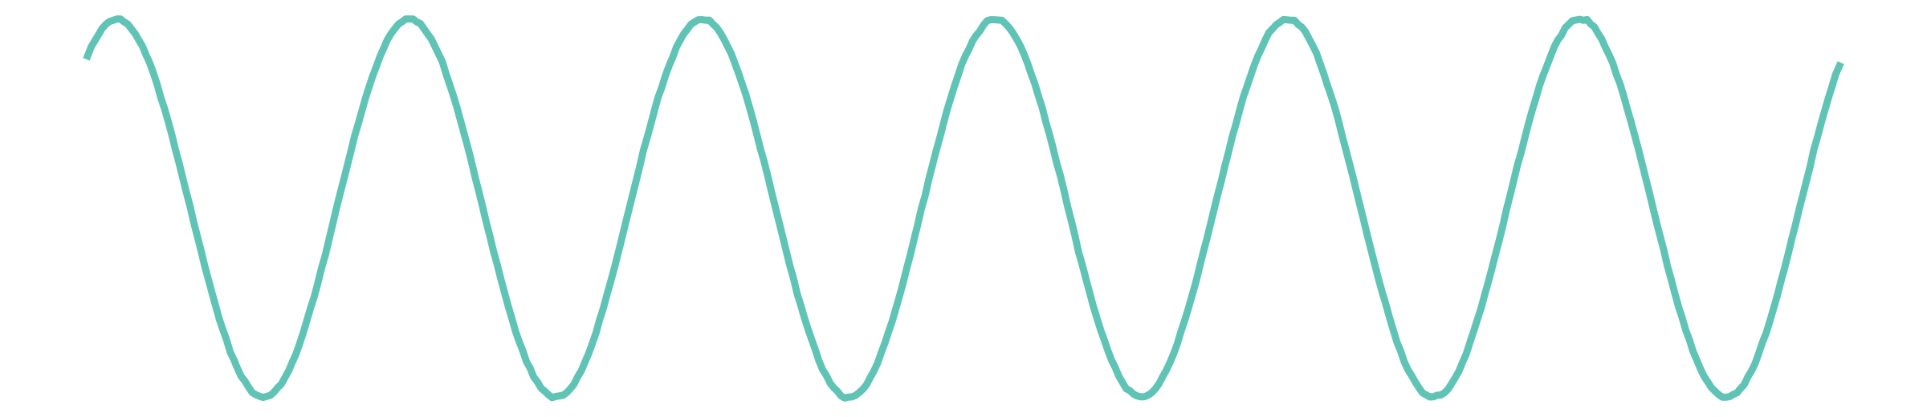
AI-BASED CONTROL SYSTEMS · USJ – ESIB
This motor looks healthy.
Is it?
?
Fault detection and diagnosis of induction motors with artificial neural networks
its stator current, phase a
Mhamad Naser Dine · Ali Srour Supervisor: Prof. Hadi Y. Kanaan
Notes:
[MHAMAD · 0:00–0:30] Good morning. I am Mhamad Naser Dine, and this is Ali Srour. Look at this motor, and at its current on the left: a clean, regular sine wave. This motor looks healthy. Is it? Keep this question in mind: we will answer it live at the end. Our project is fault detection and diagnosis of induction motors with artificial neural networks.

Slide 2
01 · THE PROBLEM
Motors break slowly, so we want to catch the fault early
Rotor bars
crack and break · the rotor becomes unequal
Stator windings
insulation fails · turns short-circuit
Bearings
hold the shaft · balls and races wear out
Goal: detect the fault while it is still small.
Listening to the Motor · Naser Dine & Srour
2
Notes:
[MHAMAD · 0:30–1:04] Induction motors drive pumps, fans and conveyors in every factory. When one stops, production stops. Motors break slowly, and most failures come from three places. [CLICK] The rotor bars, which crack and break. [CLICK] The stator windings, where the insulation fails and turns short-circuit. [CLICK] And the bearings, which hold the shaft. These faults start small and grow over weeks. [CLICK] So our goal is to detect the fault while it is still small.

Slide 3
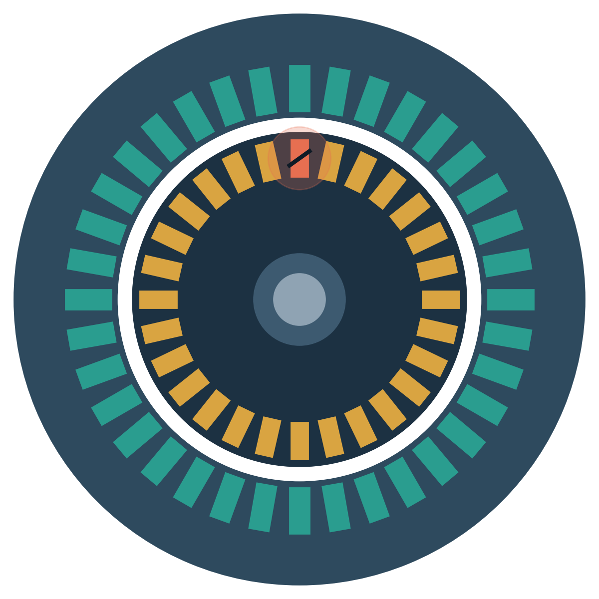
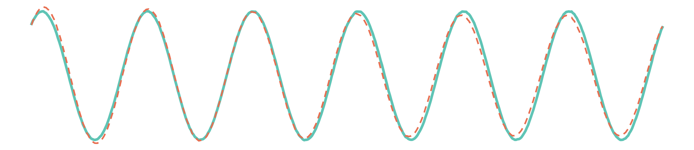
02 · THE CHALLENGE
A broken rotor bar is almost invisible in the current
━ healthy motor ╍ 3 broken bars
The two currents are almost identical: the eye cannot see the fault.
3 broken rotor bars
Listening to the Motor · Naser Dine & Srour
3
Notes:
[MHAMAD · 1:04–1:32] Here is the challenge. We built a virtual 2.2-kilowatt motor, solved its equations in Python, and broke three of its rotor bars: the orange bar. On the right, the current of the healthy motor in teal, and of the broken motor in dashed orange. [CLICK] The two currents are almost identical: the eye cannot see the fault.

Slide 4
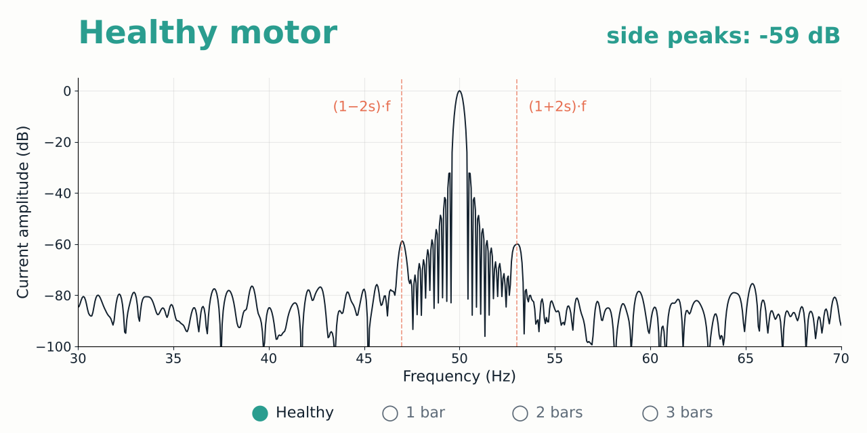
03 · MOTOR CURRENT SIGNATURE ANALYSIS
…but it is clearly visible in the frequency spectrum
Listening to the Motor · Naser Dine & Srour
4
Notes:
[MHAMAD · 1:32–2:10] But it is clearly visible in the frequency spectrum. This video shows the same motor, at 80 percent load, while the fault grows. Healthy: one peak at 50 hertz, and the side peaks stay low, at minus 59 dB. With one broken bar, two side peaks rise at one plus or minus 2s times f, exactly where the theory predicts. With three broken bars they reach minus 23 dB. The fault grows, and its fingerprint grows with it.

Slide 5
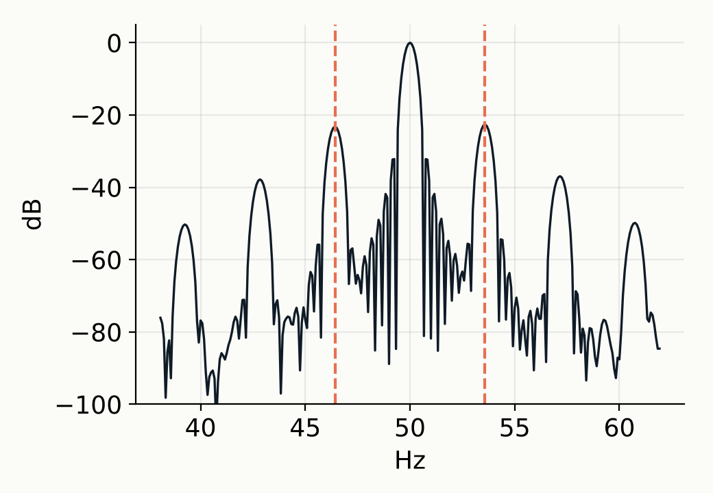
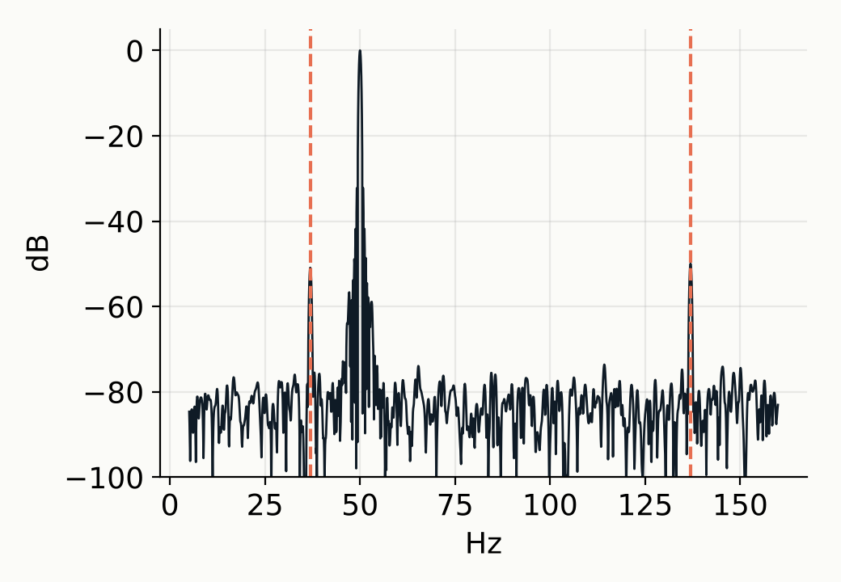
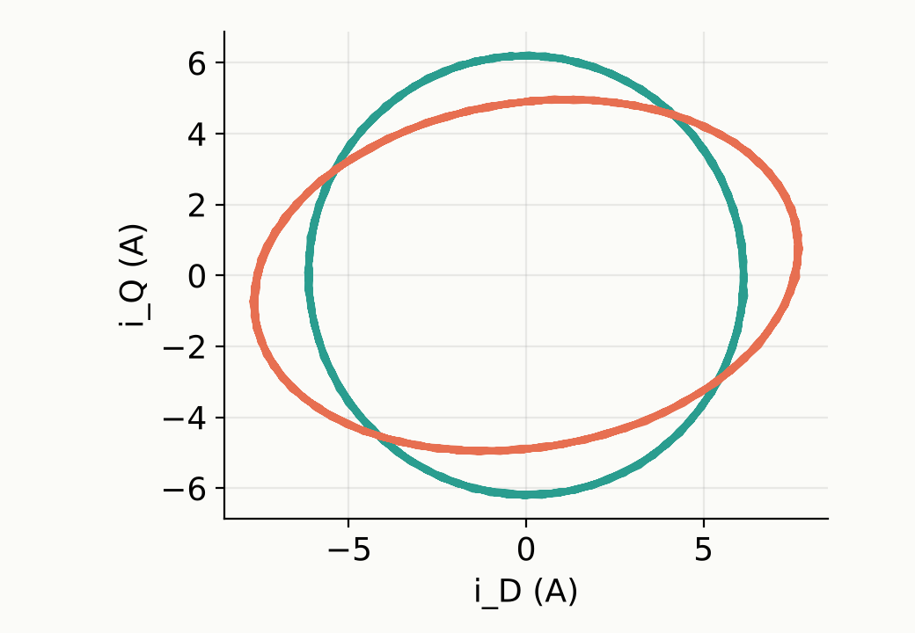
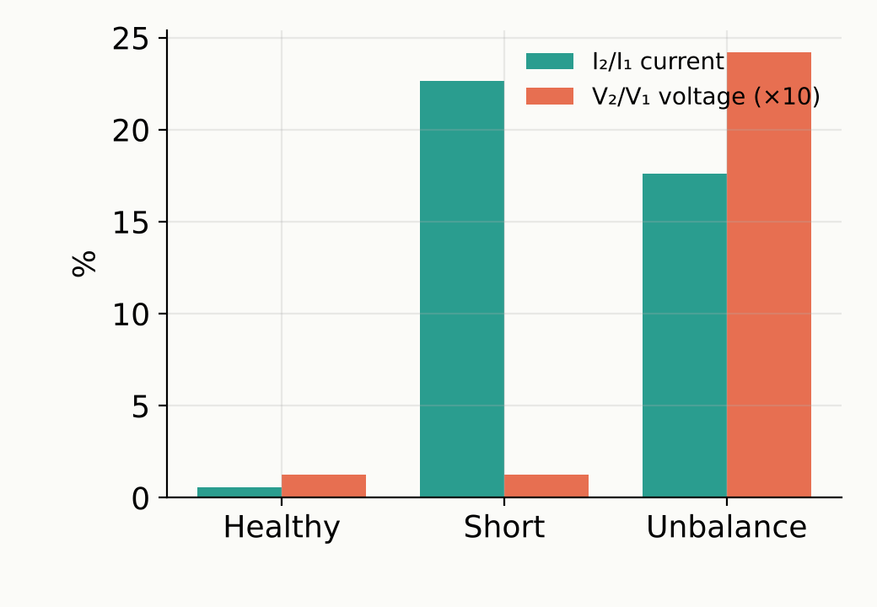
04 · FAULT SIGNATURES
Each fault leaves a different fingerprint
Broken bars
Bearing defect
Inter-turn short
Supply unbalance
side peaks at (1 ± 2s)·f
peaks at |f ± f_bearing|
Park circle → ellipse
unbalanced voltage V₂/V₁
The network must learn all four patterns, plus the healthy one.
Listening to the Motor · Naser Dine & Srour
5
Notes:
[MHAMAD · 2:10–2:45] Each fault leaves a different fingerprint. [CLICK] Broken bars: side peaks around 50 hertz. [CLICK] A bearing defect: peaks linked to the bearing frequency. [CLICK] An inter-turn short: Park’s vector, the three currents drawn as one shape, turns from a circle into an ellipse. [CLICK] And a supply unbalance: here the voltage itself is unbalanced, which tells it apart from a short circuit. The network must learn all four patterns, plus the healthy one.

Slide 6
05 · FEATURES
Each motor becomes 19 numbers
the motor with 3 broken bars (normalised values)
↓ broken-bar sidebands
Time
Balance
Park
Spectrum
Slip
Listening to the Motor · Naser Dine & Srour
6
Notes:
[MHAMAD · 2:45–3:18] A network cannot read thousands of raw samples, so each motor becomes 19 numbers, in four families: the time shape of the wave, the balance between the phases, Park’s vector, and the spectrum, plus the slip, which tells the load. These are the 19 numbers of our broken motor: the highest orange bars are exactly the broken-bar sidebands. Ali will now show how the network learns from them.

Slide 7
06 · THE NEURAL NETWORK
A neural network learns these fingerprints
19 inputs
15 hidden (tanh)
5 outputs
Healthy
96 %
Broken bars
Inter-turn short
Bearing
Supply unbalance
Back-propagation: δ = e·φ′(v), sent backward · Δw(n) = η δ y + α Δw(n−1)
Listening to the Motor · Naser Dine & Srour
7
Notes:
[ALI · 3:18–3:51] Thank you, Mhamad. These 19 numbers become the 19 inputs of a multilayer perceptron, with 15 hidden neurons and 5 outputs, one per condition. [CLICK] The hidden layer combines the inputs. [CLICK] And the output with the highest value is the diagnosis: here, broken bars, 96 percent. The network learns by back-propagation: the error is sent backward and every weight is corrected, with a momentum term to learn faster.

Slide 8
07 · DATA
The network learns from 1500 virtual motors
Healthy · 300
Broken bars · 300
Inter-turn short · 300
Bearing · 300
Supply unbalance · 300
one dot = 10 simulated motors · load 30–110 % · sensor noise · ±5 % parameter spread
Listening to the Motor · Naser Dine & Srour
8
Notes:
[ALI · 3:51–4:05] To learn, it needs examples. We simulated 1500 virtual motors, 300 per condition, with different loads, sensor noise and parameter spread. Each dot is ten motors.

Slide 9
07 · DATA
We split them: learn, know when to stop, final exam
Training · 60 %
Test · 20 %
Validation · 20 %
adjusts the weights
stops at point A
the final, honest grade
Listening to the Motor · Naser Dine & Srour
9
Notes:
[ALI · 4:05–4:24] Then we split them, exactly as in the course. Sixty percent training, to adjust the weights. Twenty percent test, to decide when to stop. And twenty percent validation, never seen during learning: the final, honest grade.

Slide 10
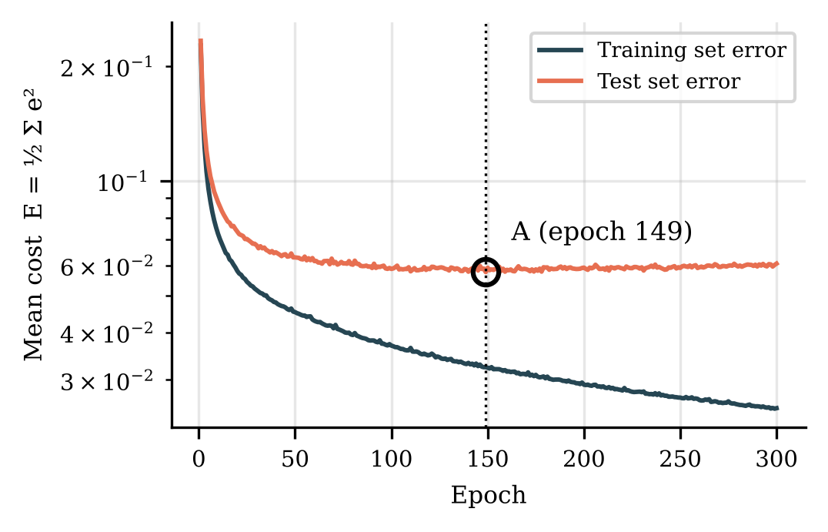
08 · GENERALISATION
It stops at point A, before it starts memorising
Training error
keeps falling
Test error
stops falling at A
Point A
we keep these weights
Listening to the Motor · Naser Dine & Srour
10
Notes:
[ALI · 4:24–4:44] Here is learning in action. [CLICK] The training error keeps falling. [CLICK] But the test error stops falling at epoch 149. [CLICK] That is point A, and we keep these weights. After point A the network would start memorising instead of learning.

Slide 11
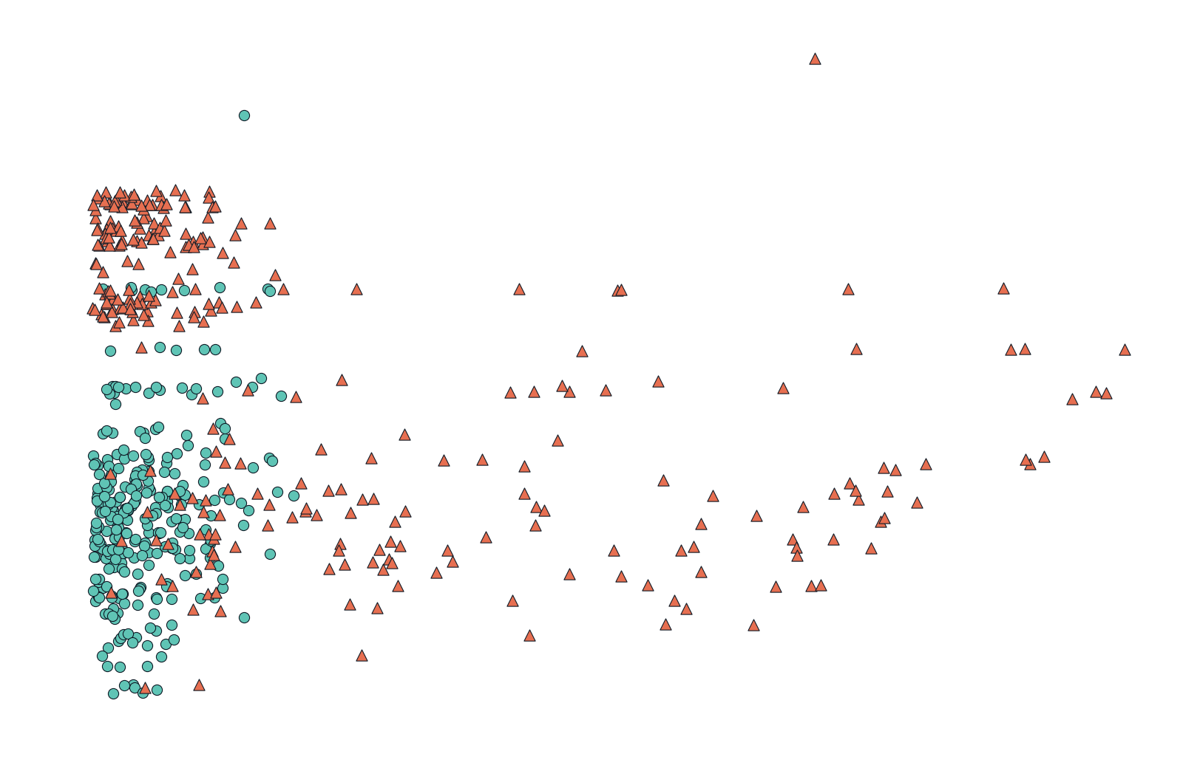
09 · WHY A HIDDEN LAYER?
A single layer can only draw a straight line…
● Healthy
▲ Broken bars or short
y-axis: broken-bar sideband
Perceptron
86.7 %
validation accuracy
I₂/I₁ (sees the short circuit) →
Listening to the Motor · Naser Dine & Srour
11
Notes:
[ALI · 4:44–5:07] Why do we need a hidden layer? With only two features, the healthy motors sit in one corner, and the faulty ones are everywhere else, like the XOR problem in the course. A single layer can only draw a straight line: the Perceptron reaches 86.7 percent.

Slide 12
09 · WHY A HIDDEN LAYER?
…a hidden layer bends the boundary
● Healthy
▲ Broken bars or short
y-axis: broken-bar sideband
MLP · 10 hidden
92.5 %
validation accuracy · +5.8 points
I₂/I₁ (sees the short circuit) →
Listening to the Motor · Naser Dine & Srour
12
Notes:
[ALI · 5:07–5:16] With a hidden layer, the boundary bends around the corner, and the MLP reaches 92.5 percent.

Slide 13
10 · RESULTS
MLP-BP is the best: 94 %, the RBF only 78 %
MLP-BP (back-propagation)
94.0 ± 1.5 %
MLP + momentum
93.7 ± 1.5 %
MLP + adaptive η
93.6 ± 1.4 %
Perceptron
93.3 ± 1.7 %
MLP-LM (fastest)
92.3 ± 2.1 %
ADALINE
89.6 ± 1.7 %
RBF
77.5 ± 3.9 %
Diagnosis, 5 classes · validation accuracy · mean ± std of 10 independent runs · all written from scratch in NumPy
Listening to the Motor · Naser Dine & Srour
13
Notes:
[ALI · 5:16–5:48] We compared seven networks, all written from scratch, and trained each one ten times. The winner is the MLP with back-propagation: 94 percent for five classes. Momentum and the adaptive learning rate are very close. Levenberg–Marquardt is the fastest, reaching point A in only seven iterations. And the RBF network reaches only 78 percent, because its Gaussian neurons are local and cannot cover 19 dimensions.

Slide 14
11 · RELIABILITY
Even one broken bar is found 89 % of the time
89 %
100 %
medium and severe faults found
8
hidden neurons are enough
of early faults found (severity 1)
on 500 new motors never seen
31 %
at 5 % sensor noise: our limit
Lesson: one run can lie — we report mean ± std over 10 runs.
Listening to the Motor · Naser Dine & Srour
14
Notes:
[ALI · 5:48–6:22] Can we trust it? On 500 new motors that it never saw, it finds 89 percent of early faults, even a single broken bar. [CLICK] And 100 percent of medium and severe faults. [CLICK] Eight hidden neurons are enough. [CLICK] Our limit: with 5 percent sensor noise, accuracy falls to 31 percent, so the network must be trained with the noise of the real sensors. Now, back to our mystery motor.

Slide 15
12 · LIVE DEMO
Live demo: is the mystery motor healthy?
1
The program creates a motor and hides its condition
?
2
The network reads only the current
3
We reveal the truth: was it right?
Listening to the Motor · Naser Dine & Srour
15
Notes:
[MHAMAD · 6:22–6:36] Is the mystery motor healthy? [CLICK] The program creates a motor and hides its condition. [CLICK] The network reads only the current. [CLICK] And we reveal the truth. Let’s try it.
LIVE DEMO (2 min):
(0:00) Switch to the browser. The app is already open on Live diagnosis demo, Networks Saved, network MLP-BP, noise 1 %.
(0:05) “This is our application. I choose Random unknown motor and click Acquire signals and diagnose. Even we do not know the condition.”
(0:20) Read the verdict aloud: “The network says: FAULTY, broken rotor bars, 96 percent. The bars show how sure it is for each condition.”
(0:35) Open Reveal the true condition: “The truth is… broken rotor bars. The network was right.” (If wrong: “a severity-1 fault at light load, the hard 11 percent.”)
(0:50) “One more.” Click again, read the verdict, reveal.
(1:10) “Now the hardest case.” Choose Broken rotor bars, severity 1 (one single bar), load 40 %, and click. “Even one broken bar is detected: look at the small side peaks in the spectrum.”
(1:45) “From the current to the diagnosis in about one second. Ali will conclude.” Switch back to slide 16.

Slide 16
13 · CONCLUSION
From the current to the diagnosis
Healthy ✓
or which fault ⚠
virtual motor
spectrum
19 numbers
neural network
verdict
94.0 ± 1.5 %
89 %
3 sets · point A · 10 runs
MLP-BP, 5 classes, 10 runs
of early faults found
an honest evaluation
Next: validate on real motor currents · estimate the severity · predict the remaining life
Thank you — questions?
Listening to the Motor · Naser Dine & Srour
16
Notes:
[ALI · 6:36–7:08] To conclude: from the current to the diagnosis. A virtual motor, its spectrum, 19 numbers, a neural network, and a verdict. The MLP reaches 94 percent, finds 89 percent of early faults, and was evaluated honestly with three sets, point A and ten runs. Next, we will validate it on real motor currents. Thank you — we are happy to answer your questions.

